Slide 1
Memorie

Slide 2
Memory Arrays
Efficiently store large amounts of data
3 common types:
Dynamic random access memory (DRAM)
Static random access memory (SRAM)
Read only memory (ROM)
M-bit data value read/ written at each unique N-bit address

Slide 3
Memory Arrays
2-dimensional array of bit cells
Each bit cell stores one bit
N address bits and M data bits:
2^{N} rows and M columns
Depth: number of rows (number of words)
Width: number of columns (size of word)
Array size: depth × width = 2^{N} × M

Slide 4
Memory Array Example
2² × 3-bit array
Number of words: 4
Word size: 3-bits
For example, the 3-bit word stored at address 10 is 100

Slide 5
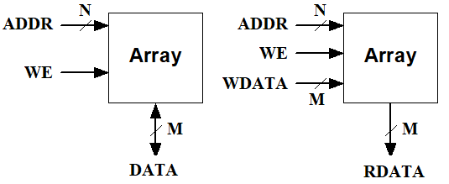
Memory Arrays
A RAM array has the following ports:
Address port with 2^{N}xM bits has:
N address bits (inputs)
M bidirectional data bits. Or M read_data output bits + M write_data input bits
A WE (Write Enable) signal

Slide 6
Memory Array Bit Cells

Slide 7
Memory Array Bit Cells
0
Z
1
Z

Slide 8
Memory Array
Wordline:
like an enable
single row in memory array read/written
corresponds to unique address
only one wordline HIGH at once

Slide 9
Types of Memory
Random access memory (RAM): volatile
Read only memory (ROM): nonvolatile

Slide 10
RAM: Random Access Memory
Volatile: loses its data when power off
Read and written quickly
Main memory in your computer is RAM (DRAM)
Historically called random access memory because any data word accessed as easily as any other (in contrast to sequential access memories such as a tape recorder)

Slide 11
ROM: Read Only Memory
Nonvolatile: retains data when power off
Read quickly, but writing is impossible or slow
Flash memory in cameras, thumb drives, and digital cameras are all ROMs
Historically called read only memory because ROMs were written at manufacturing time or by burning fuses. Once ROM was configured, it could not be written again. This is no longer the case for Flash memory and other types of ROMs.

Slide 12
Types of RAM
DRAM (Dynamic random access memory)
SRAM (Static random access memory)
Differ in how they store data:
DRAM uses a capacitor
SRAM uses cross-coupled inverters

Slide 13
DRAM
Data bits stored on capacitor
Dynamic because the value needs to be refreshed (rewritten) periodically and after read:
Charge leakage from the capacitor degrades the value
Reading destroys the stored value

Slide 14
DRAM

Slide 15
SRAM

Slide 16
Memory Arrays Review
DRAM bit cell:
SRAM bit cell:

Slide 17
Esercizi
Esercizio 1: Costruire una memoria di 1 MB e larghezza di parola di 32 bits a partire da blocchi di memoria di dimensioni 2¹⁸ × 8
Esercizio 2: Costruire una memoria di 1 MB e larghezza di parola di 32 bits a partire da blocchi di memoria di dimensioni 2¹⁶ × 32
Esercizio 3: Costruire una memoria di 1 MB e larghezza di parola di 8 bits a partire da blocchi di memoria di dimensioni 2¹⁸ × 32

Slide 18
Logic Using ROM/PLA/FPGA

Slide 19
ROM: Dot Notation

Slide 20
ROM Storage

Slide 21
ROM Logic
Data₂ = A₁ ⊕ A₀
Data₁ = A₁ + A₀
Data₀ = A₁A₀

Slide 22
Example: Logic with ROMs
Implement the following logic functions using a 2² × 3-bit ROM:
X = AB
Y = A + B
Z = A B

Slide 23
Example: Logic with ROMs
Implement the following logic functions using a 2² × 3-bit ROM:
X = AB
Y = A + B
Z = A B

Slide 24
Logic with Any Memory Array
Data₂ = A₁ ⊕ A₀
Data₁ = A₁ + A₀
Data₀ = A₁A₀

Slide 25
Logic with Memory Arrays
Implement the following logic functions using a 2² × 3-bit memory array:
X = AB
Y = A + B
Z = A B

Slide 26
Logic with Memory Arrays
Implement the following logic functions using a 2² × 3-bit memory array:
X = AB
Y = A + B
Z = A B

Slide 27
Logic with Memory Arrays
Called lookup tables (LUTs): look up output at each input combination (address)

Slide 28
Multi-ported Memories
Port: address/data pair
3-ported memory
2 read ports (A1/RD1, A2/RD2)
1 write port (A3/WD3, WE3 enables writing)
Register file: small multi-ported memory

Slide 29
Logic Arrays
PLAs (Programmable logic arrays)
AND array followed by OR array
Combinational logic only
Fixed internal connections
FPGAs (Field programmable gate arrays)
Array of Logic Elements (LEs)
Combinational and sequential logic
Programmable internal connections

Slide 30
PLAs
X = ABC + ABC
Y = AB

Slide 31
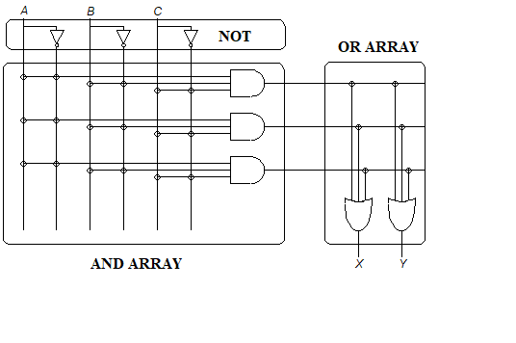
PLAs
Un PLA (Programmable Logic Array) è una rete combinatoria con:
- M ingressi
- P uscite
3 stadi interni:
uno stadio di inversione dei segnali di ingresso,
una matrice di AND
una matrice di OR.

Slide 32
PLAs
Un PLA (Programmable Logic Array) è una rete combinatoria con:
Il piano AND può realizzare fino ad N implicanti
Questi implicanti possono essere utilizzati per realizzare fino a P funzioni logiche nella forma SOP

Slide 33
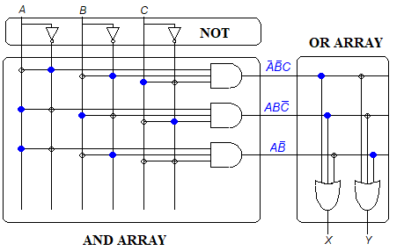
Esempio di programmazione PLA
X = ABC + ABC
Y = AB

Slide 34
PLAs: Dot Notation

Slide 35
FPGA: Field Programmable Gate Array
Composed of:
LEs (Logic elements): perform logic
I/O Blocks (Input/output elements): interface with outside world
Programmable interconnection: connect LEs and IOEs
Some FPGAs include other building blocks such as multipliers and RAMs

Slide 36
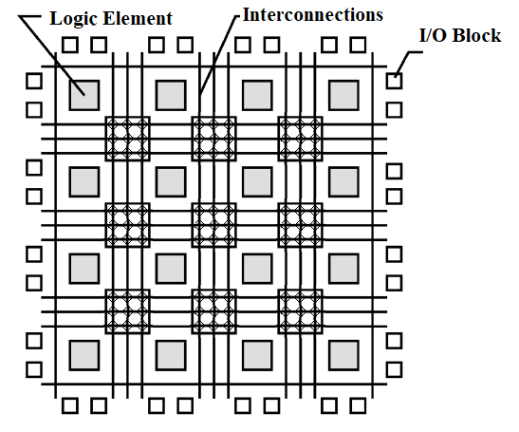
General FPGA Layout

Slide 37
LE: Logic Element
Composed of:
LUTs (lookup tables): perform combinational logic
Flip-flops: perform sequential logic
Multiplexers: connect LUTs and flip-flops

Slide 38
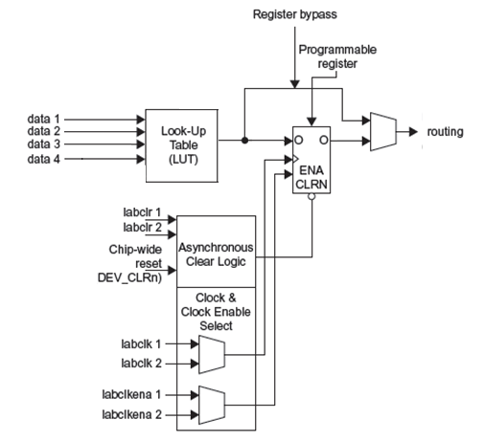
Logic Element
The Logic element has:
1 four-input LUT
1 registered output
1 combinational output

Slide 39
LE Configuration Example
Show how to configure a Cyclone IV LE to perform the following functions:
X = ABC + ABC
Y = AB

Slide 40
LE Configuration Example
Show how to configure a Cyclone IV LE to perform the following functions:
X = ABC + ABC
Y = AB
(
A
)
(
B
)
(
C
)
(
X
)
data 1
data 2
data 3
data 4
LUT output
0
0
0
X
0
0
0
1
X
1
A
data 1
0
1
0
X
0
B
data 2
0
1
1
X
0
C
data 3
X
1
0
0
X
0
0
data 4
1
0
1
X
0
LUT
1
1
0
X
1
LE 1
1
1
1
X
0
(
A
)
(
B
)
(Y
)
data 1
data 2
data 3
data 4
LUT output
0
0
X
X
0
A
data 1
0
1
X
X
0
B
data 2
1
0
X
X
1
0
data 3
Y
1
1
X
X
0
0
data 4
LUT
LE 2

Slide 41
FPGA Design Flow
Using a CAD tool
Enter the design using schematic entry or an HDL
Simulate the design
Synthesize design (create the configuration bitstream)
Download the configuration onto the FPGA
Test the design

